Slide 1

RAship Work Summary Report
Chenya PEI
Z Lab
2024.12.23

Slide 2
Work Contents
White paper of urban CO₂ emissions
Structure - Contents Completed - Polish & Details
100% ✅
Paper on spatio-temporal characteristics of urban excess CO₂ in global cities
Basic Model - Structure - Preliminary Result - Time-scale Experiments - Result Discussions - Revise...
75%

Slide 3
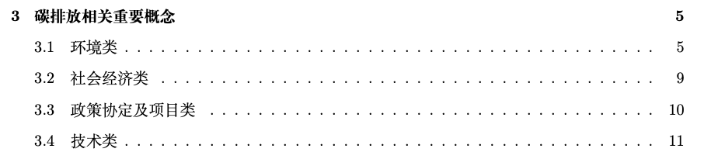
White Paper

Slide 4
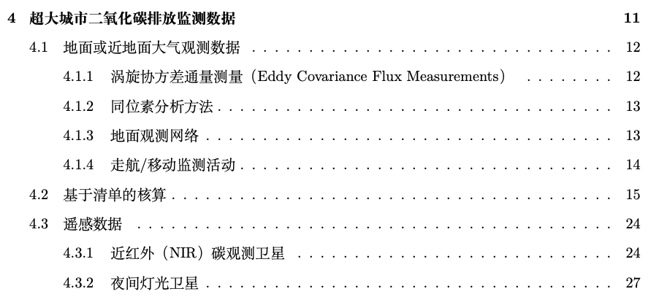
White Paper

Slide 5
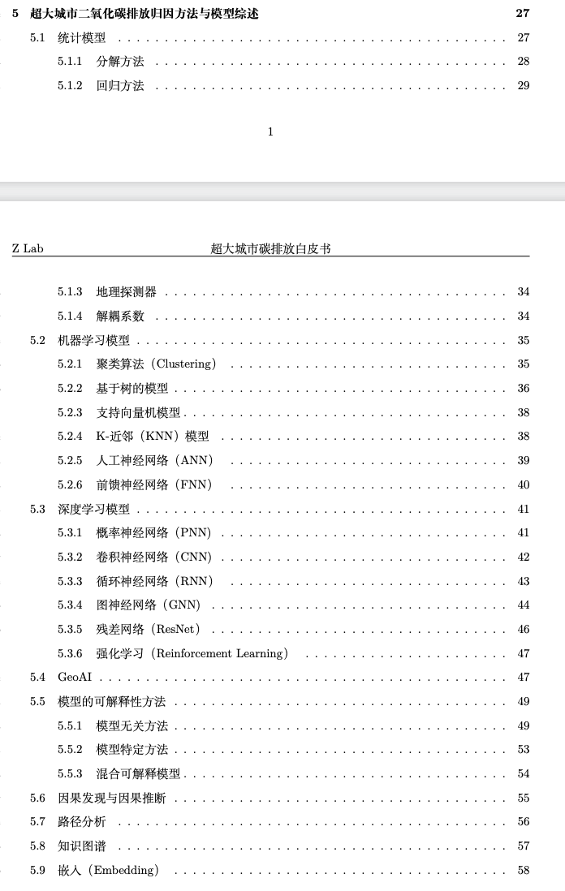
White Paper
embedding 属于 geoai
路径分析 属于 统计模型 direct/indirect correlation
因果分析
深度学习属于机器学习 再加 可解释性
机器学习 简单神经网络。。。
4个section
统计模型 时空方法 gtwr类似
5.1.2 ols在碳的领域

Slide 6
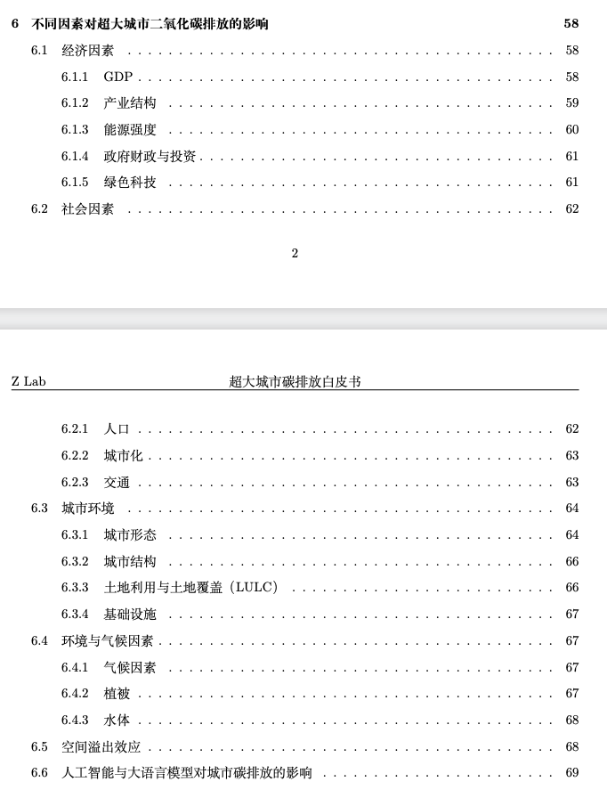
White Paper
ai和llm 补充

Slide 7
White Paper
调整细节
y的数据 概念
数据 可选的数据 结合需求
全球数据集 - 同一
时间尺度 - 概念、物理过程、关注的问题
空间、时间
meta 比较差异性 future oppo
分析方法：科学分析 解释性 理解机制 / 有效的治理政策 ～ 尺度
词典的形式 长摘要/总结 ipcc note
towards reliable carbon analytics 影响
review的文章 覆盖的角度 nature reviews/earth & environment/ecology
annual reviews

Slide 8
Scientific Paper
Table 1. Dataset in this research
Variable | Description | Dataset | Resolution | References
’AE’ | Anthropogenic emissions of seven sectors (unit: kg C h⁻¹) | GRACED | Daily, 0.1° | (Dou et al., 2022, 2023)
’LAI’ | Leaf Area Index (unit: area fraction) | ERA5 | Hourly, 0.1° | (Mu˜noz Sabater, 2019)
’u10m’ | Eastward component of the wind at 10 m above the surface of the Earth (unit: m/s)
’v10m’ | Northward component of the wind at 10 m above the surface of the Earth (unit: m/s)
’svwl1’ | Surface net solar radiation (unit: J m⁻²)
’srf’ | Solar radiation flux (unit: J m⁻² day⁻¹) | AgERA5 | Daily, 0.1° | (Boogaard et al., 2020)
Human
activities
Vegetation
Wind
Soil
Radiation

Slide 9

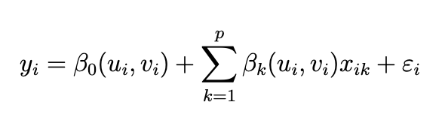
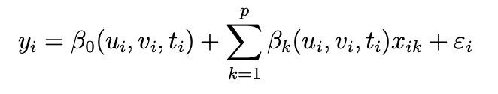
Scientific Paper
Modeling
OLS
general, simple linear, global
GWR
spatial, local
GTWR
spatial and temporal, local
adaptive kernel -> optimal bw, tau
Anthropogenic emissions
Vegetation
Wind
Soil
Radiation
Net CO₂ Emissions
Spatio-temporal distance
Spatial distance

Slide 10
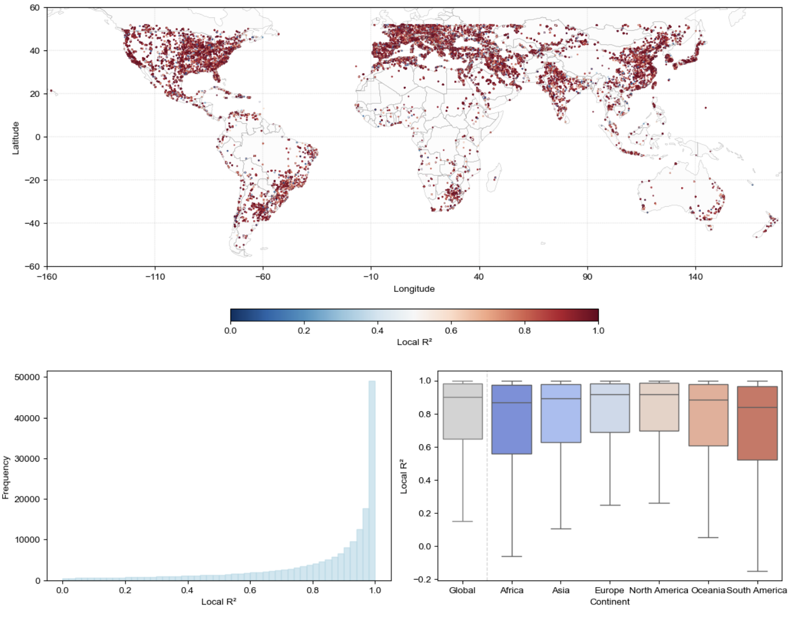
Results
Model Selection
GTWR was selected for the best performance, also implying the spatio-temporal characteristics of NE.
Showed excellent performance in global cities.
Model | R² | AICc
OLS | 0.020 | 1.36e+06
GWR | 0.467 | 917909.5
🌟GTWR | ～0.828 | ～135165.4
GTWR Model Performance

Slide 11
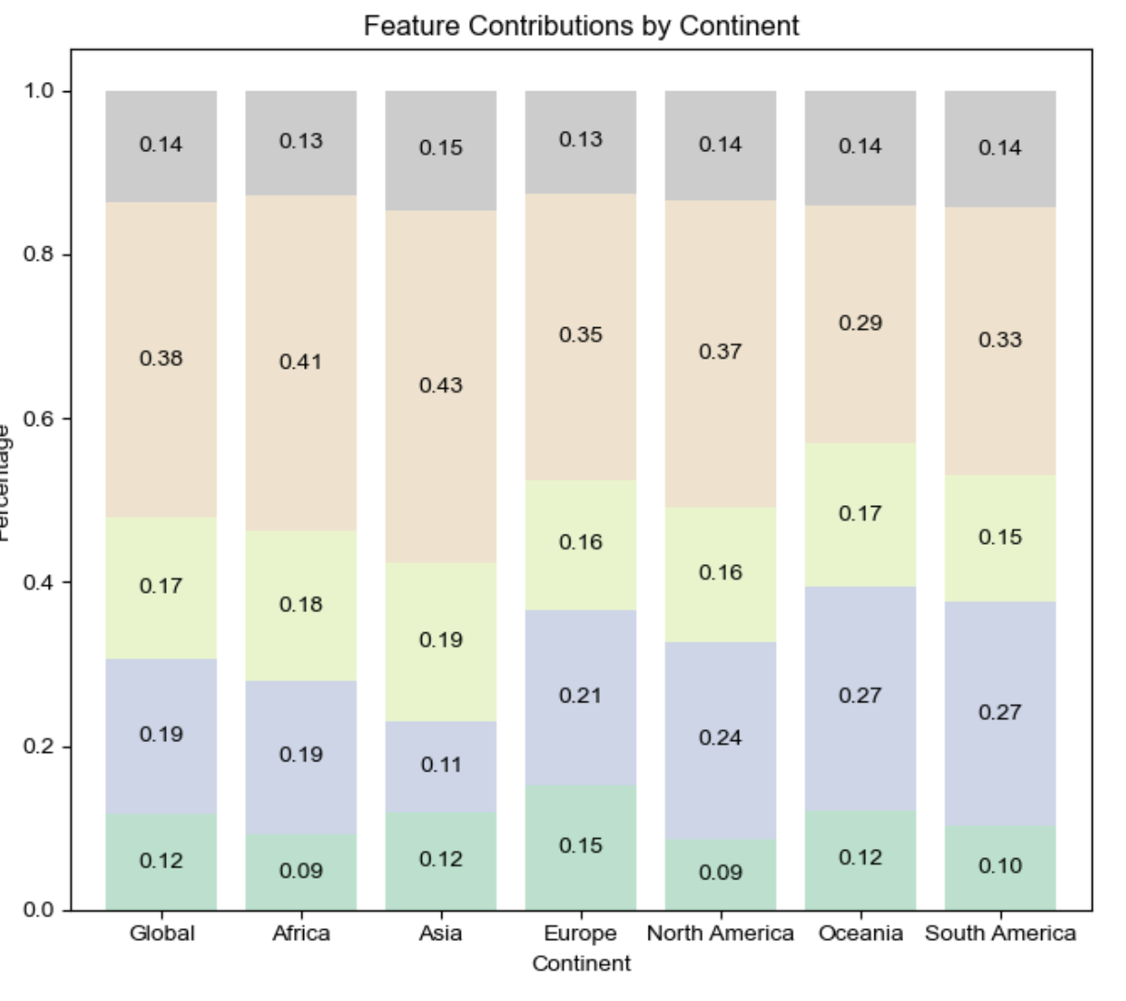
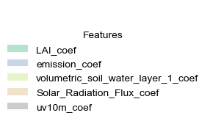
Results
Feature Contribution
Feature showed different contribution patterns in 6 continents, where net emissions in Europe was strongly impacted by forests than others and Asia has lower anthropogenic effects in emissions.
x & y variation
季节性变化 总量的变化
gtwr
lai略有低估？

Slide 12
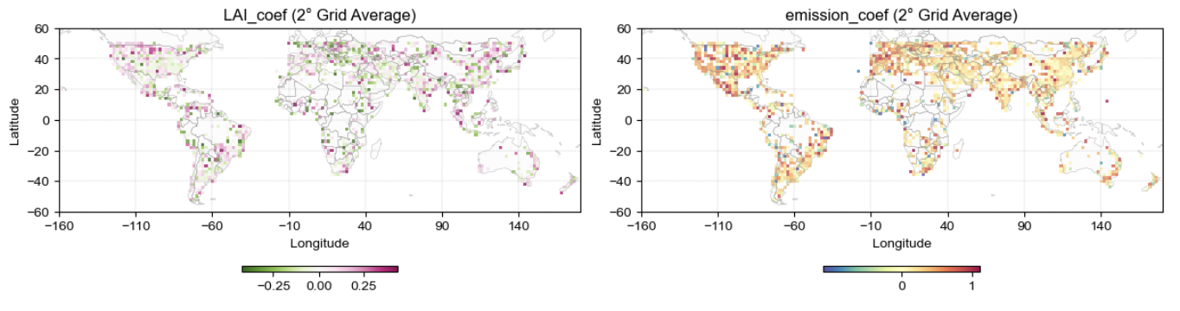
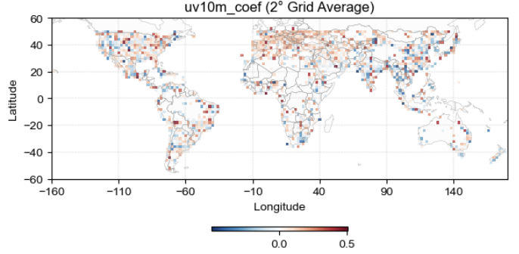
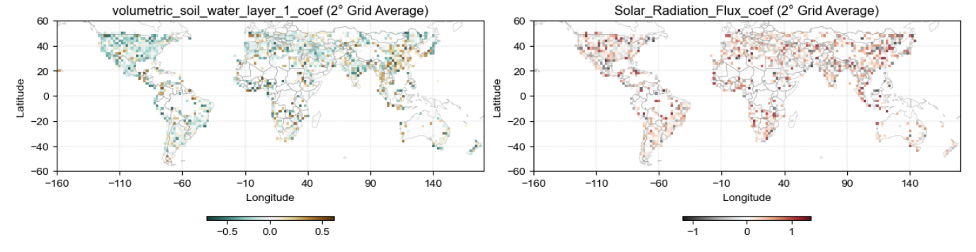
Results
Vegetation promoted carbon emissions in Northeast China, North America, etc., while reduced them in cities near the equator and European regions. ~release stored carbon of boreal forests in cold periods
Anthropogenic emissions were severe for local net emissions in America, Mexico, South Africa, Western Europe, etc.
Wind took the emissions of western America, Southeast Asia, Northern China, etc., but brought them to Eastern America, Europe, southern China, etc. ~transport among high and low pollution
Soil water volume increased the emissions in Eastern China, and Southeast Asia. ~wetlands?
Radiation was positive in most regions of the world, but declined net emissions in Western America, part of Mexico, etc.

Slide 13
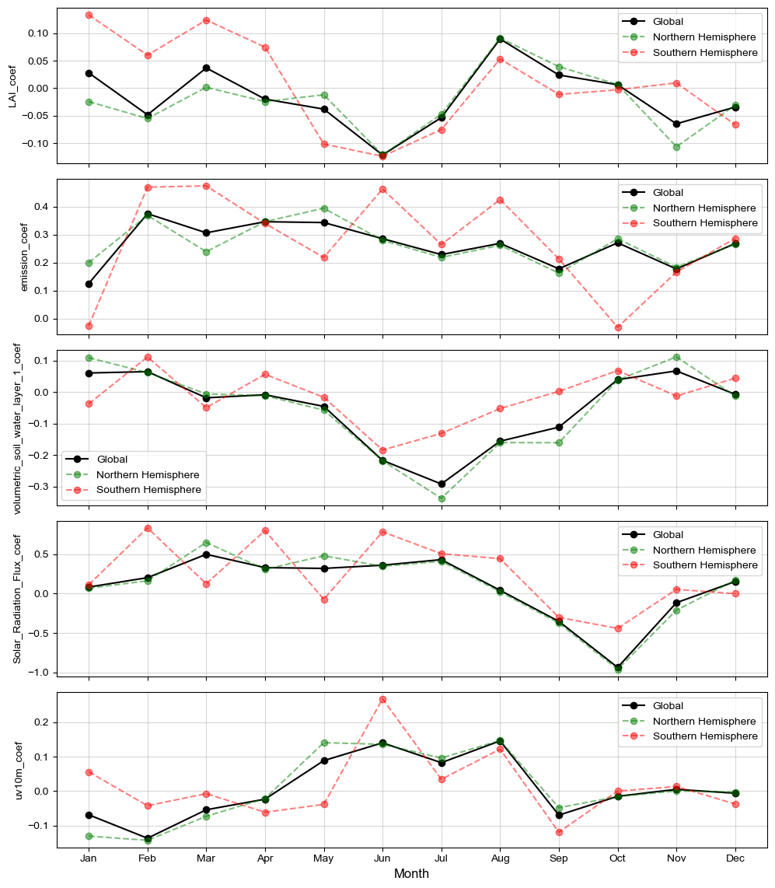
Results
LAI
AE
Soil
Water
Radiation
Wind
Temporal Analysis
Forests decreased net emissions in the summertime, while enhanced them in the autumn and winter, dominated by vegetation in the northern hemisphere.
-检查代码 and 植被的大尺度文献
For AE, the degree of promotion saw a relatively stable trend (0.1~0.36) in the whole year.
Soil water volume inhibited the emissions in the summer with the lowest point in July. ~anaerobic atmosphere?
Radiation reduced the emissions in the wintertime.
-对植被的影响 -南北半球
Wind promoted the net emissions in the summer, but slightly reduced emissions in the spring.
南半球生态系统小

Slide 14
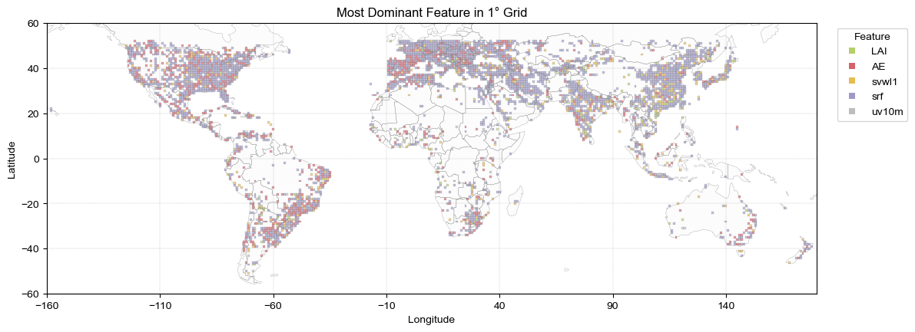
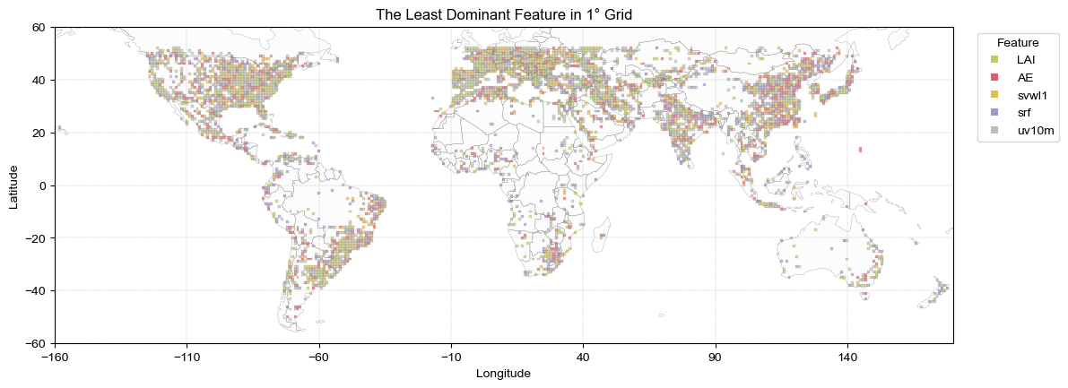
Results
Dominant Features
Although most of the cities were dominated by the radiation, human activities were more essential in some regions of central America and Western Europe.
图可读性差 dominant feature （除去rad
spatial unit + /clustering。。。
Vegetation is the least important feature in urban areas American and European cities, while human activities were the least one in Southeastern China.
lai-华东
分district zoom-in

Slide 15
Results
Dominant Features
ekc
gdp～ae coef
分段 全球城市 city size？
poor - scope 1 - enhance
rich - ae 大 - 但 impact小？
lai 分辨率？更大尺度
1. 重点结论
2. gdp的影响
3. 最重要的pattern

Slide 16
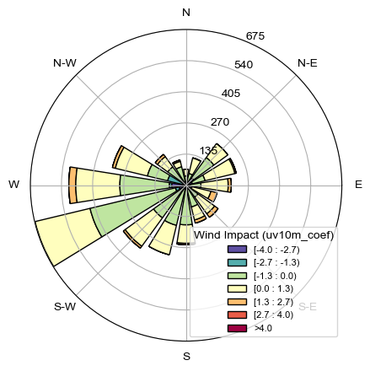
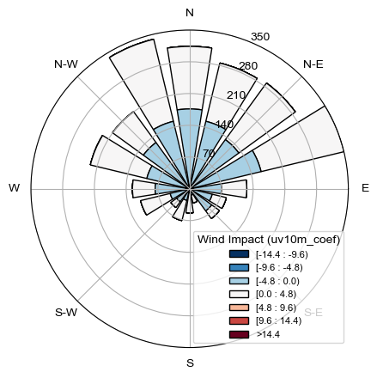
Further Discussion
In this study, five environmental parameters were proposed to interpret the net CO₂ emissions.
Further research should include the wind cycle in the world (also the vector for wind rose diagrams), soil respiration (wetland knowledge), temporal variations of features, etc.
Models of different time scales will be necessary.
China’s (1) southeastern and (2) northeastern regions

